Slide 1
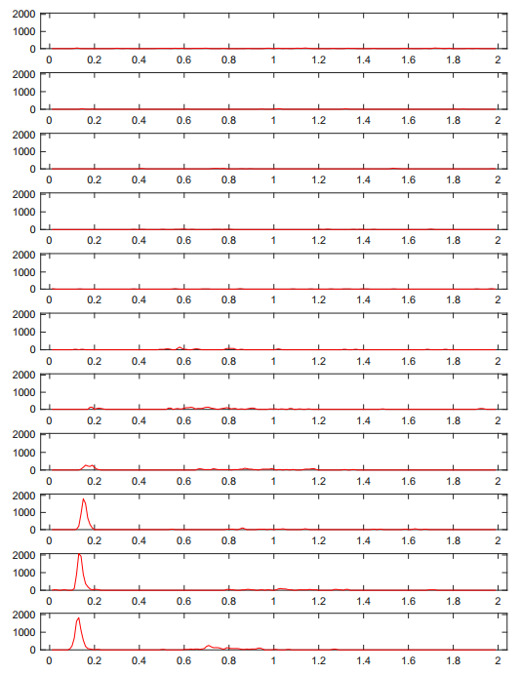
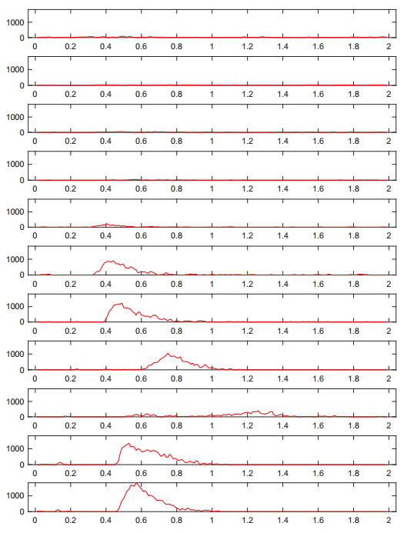
long latency → not ds?

Slide 2
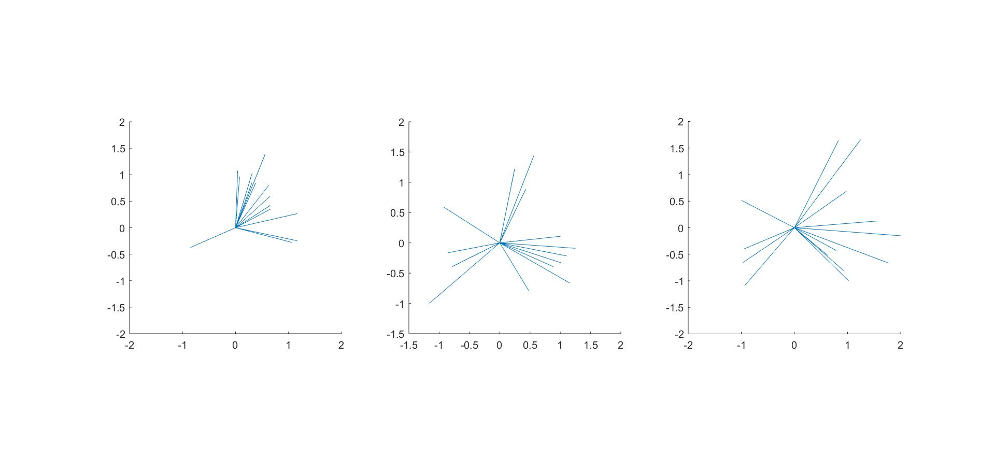
DSI vector
TP=120
TP=240
TP=480

Slide 3
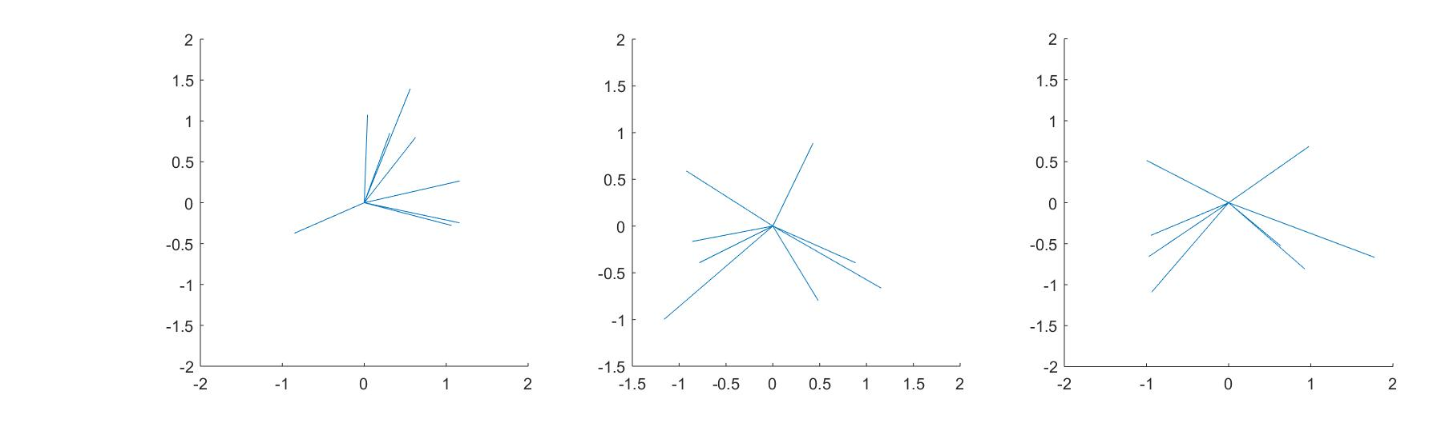
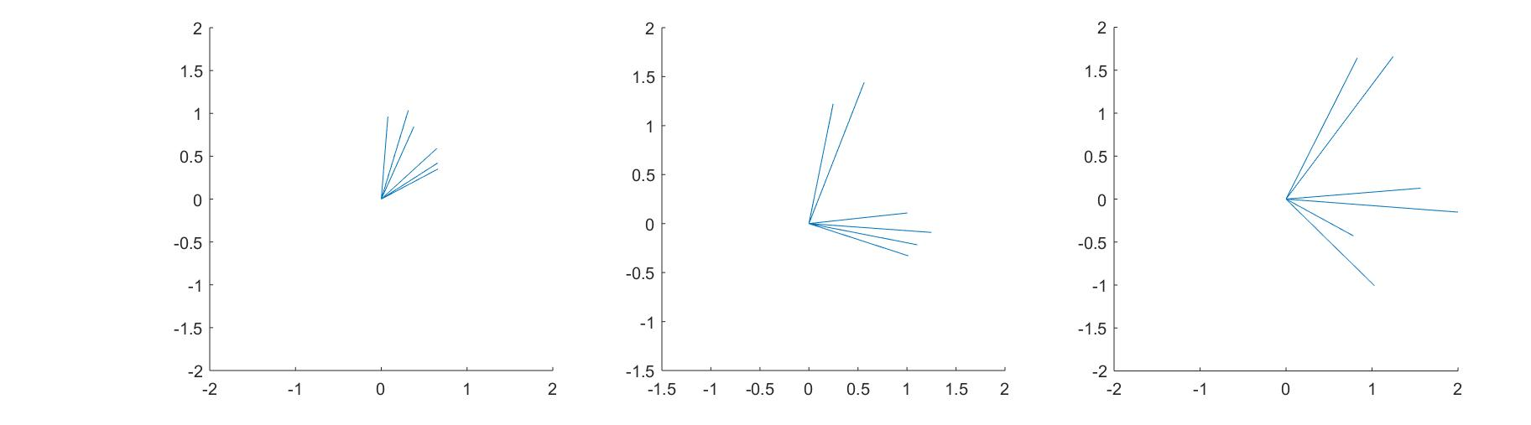
normal latency
TP=120
TP=240
TP=480
long latency

Slide 4
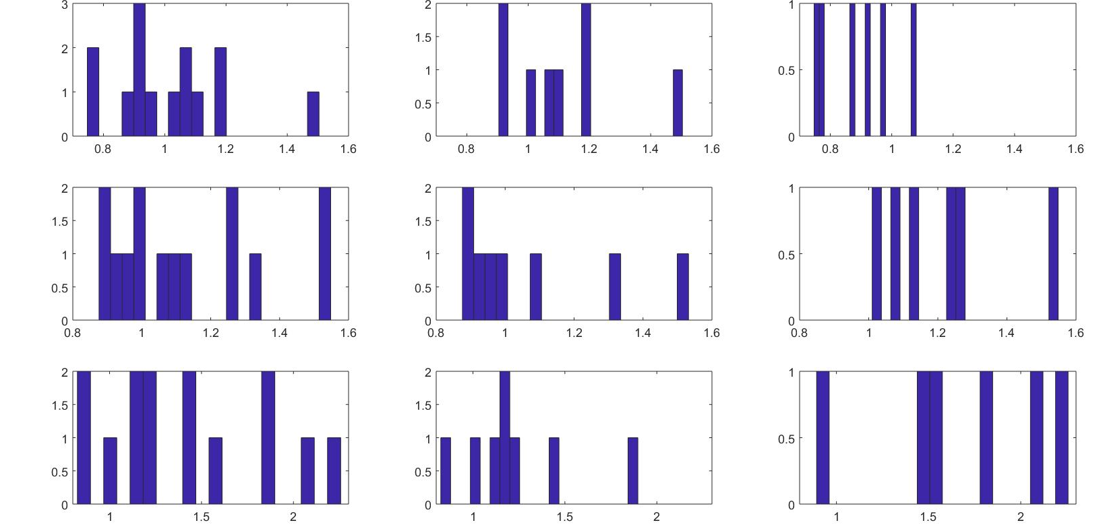
all cells
normal latency
long latency
TP=120
TP=240
TP=480

Slide 5
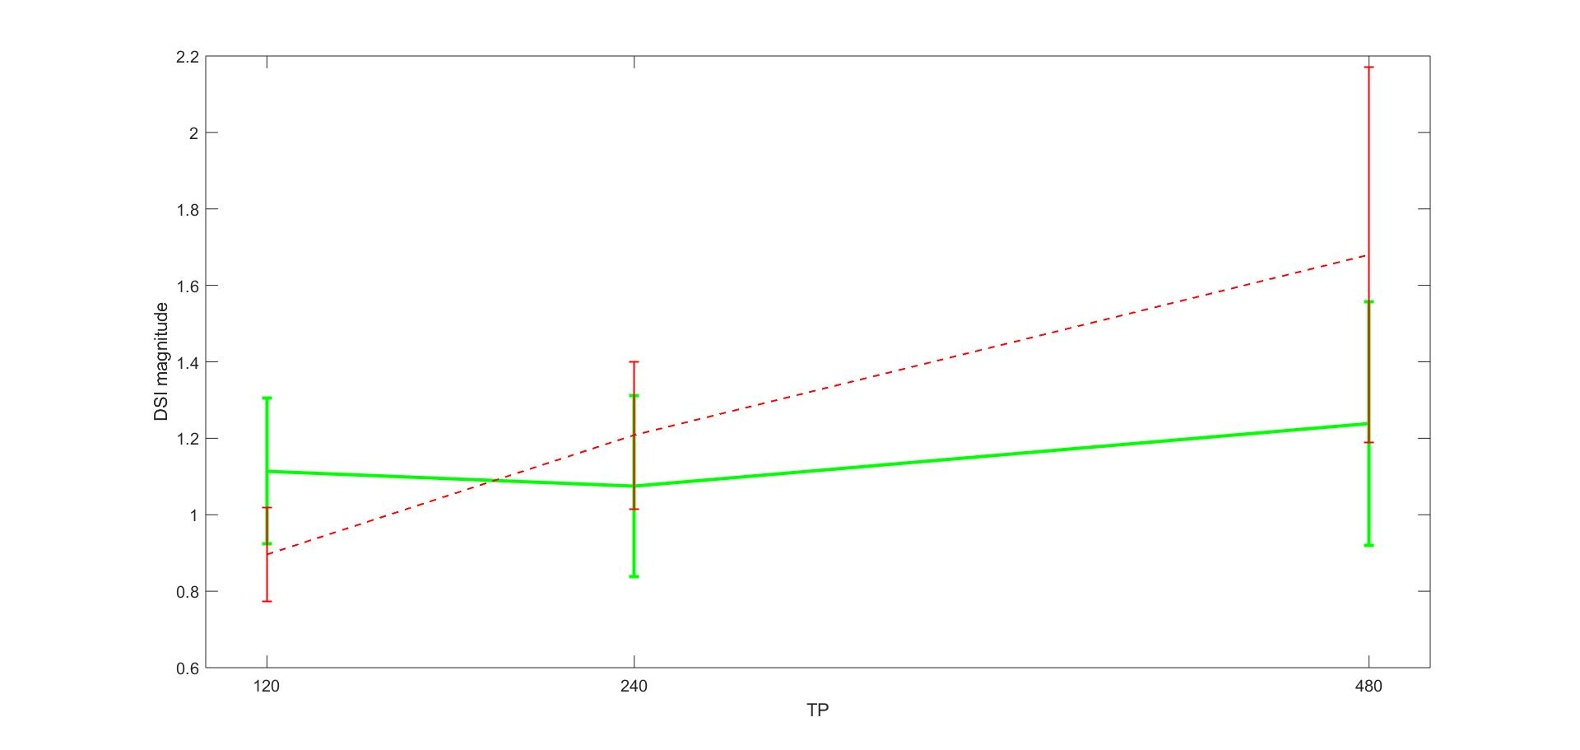
long latency
normal latency

Slide 6
long latency
DSI threshold to identify ds is only set in tp 120 & 240
normal latency
Notes:
but cannot use off response bc mice on type ds cells are less cleanly defined than rabbit

Slide 7
Why?
on type, which favors slow stim?
checking sensitivity? - on type is less sensitive
mice on type ds cells are less cleanly defined (?), can we still use off response to discern on type from on-off type?
“normal” cells almost all came from map_ei, while most “long latency” cells came from map-analysis (PCA)
what went wrong?

